Slide 1


BLUETOOTH-CONTROLLED RGB LED STRIP
18 March, 2025
Tuesday
Group2
SE1817
Internet of Things - IOT102t

Slide 2
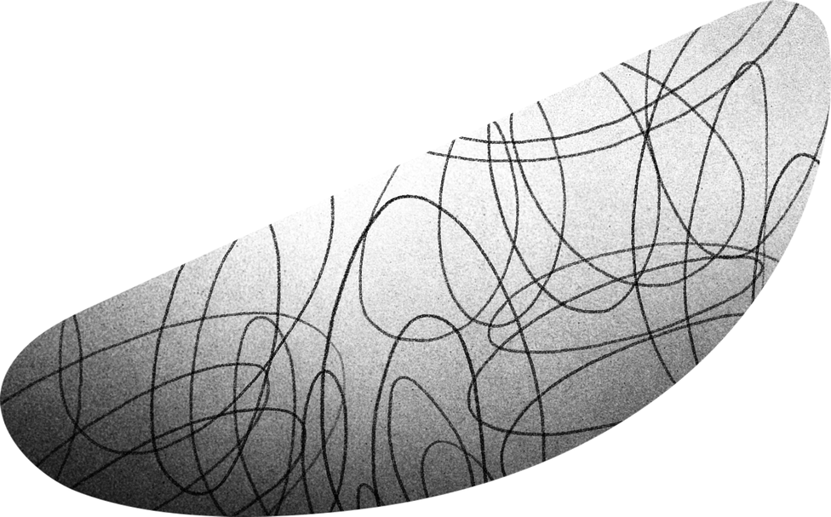




MEMBERS LIST
01
03
Leader
Trương Hào Hiệp
SE181943
Trương Thị Kim Lý
SE181957
02
04
Nguyễn Mai Tường Vy
SE181954
Trịnh Bích Trầm
SE181958

Slide 3
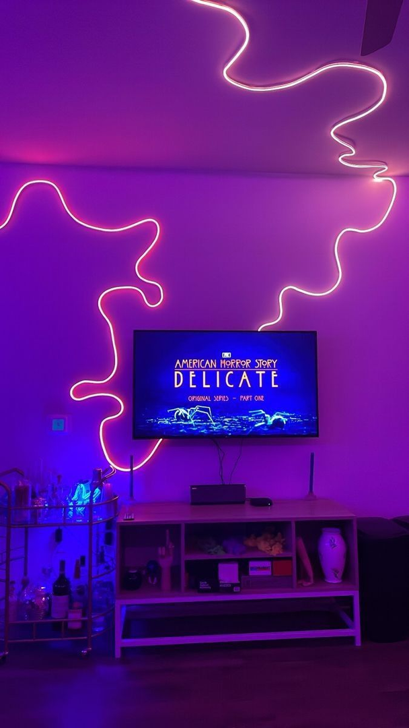

CONTEXT
Smart lighting systems are increasingly popular for both illumination and decorative effects. RGB LED lights offer flexible color control, ideal for homes, gaming rooms, cafés, and events.
Many systems still use infrared control, which limits customization. With Bluetooth and Arduino, users can now easily control lighting via a mobile app.
The "Bluetooth-Controlled RGB LED Strip" project provides a smart solution, allowing users to change colors, light effects, and sync flashing with music through their phones.

Slide 4








CONTENT
Introduce about our project
Actual photos of Project
Block Diagram
Demo of Project
Function of Devices
Conclusion
Flowchart
Future Development

Slide 5

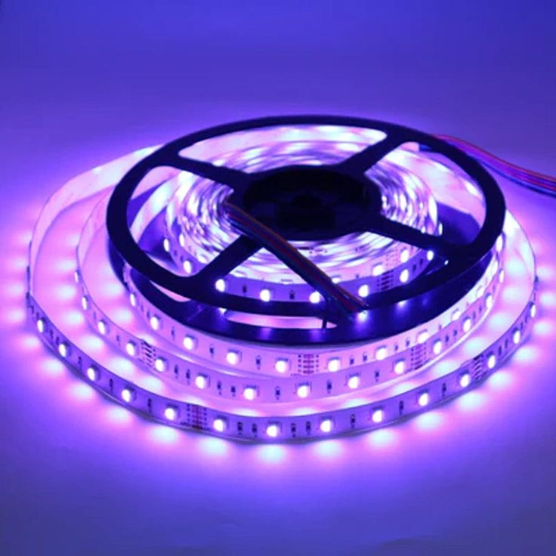

INTRODUCTION ABOUT PROJECT
The "Bluetooth-Controlled RGB LED Strip" project is designed to allow users to easily control an LED strip using a mobile app via a Bluetooth connection with Arduino.
Additionally, the system integrates a sound sensor, enabling the lights to blink in response to ambient sound while maintaining the selected color.

Slide 6

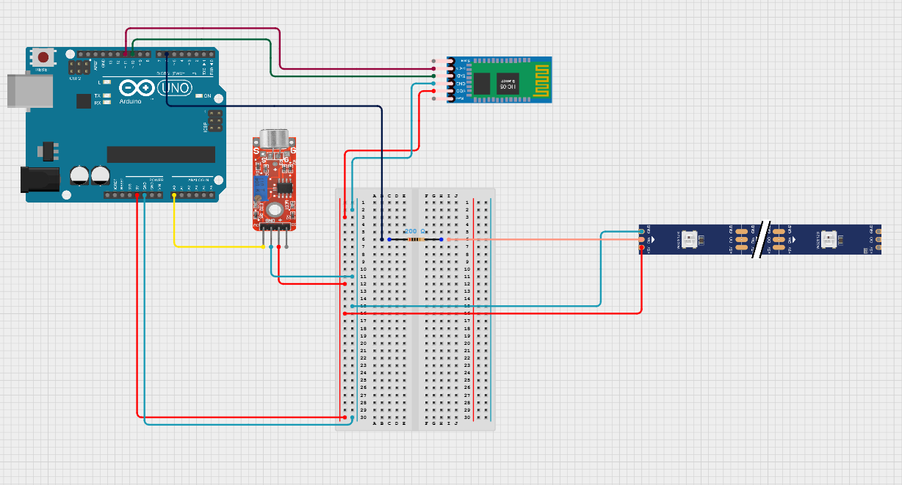
CIRCUIT

Slide 7
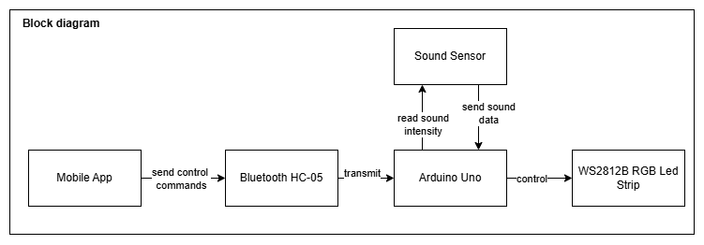
BLOCK DIAGRAM

Slide 8
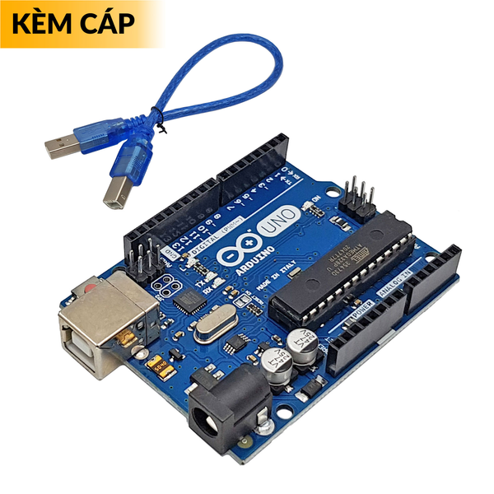
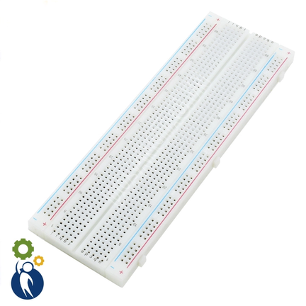
THE FUNCTION OF DEVICES
Arduino:
Arduino is an open-source electronics platform that allows for easy programming, sensor connectivity, device control, communication through various protocols, Internet integration for IoT projects
2. Board Test:
It is a prototype circuit board that helps engineers and electronics students design and test circuit prototypes without the need for soldering components. It is convenient for experimentation and rapid circuit development.

Slide 9
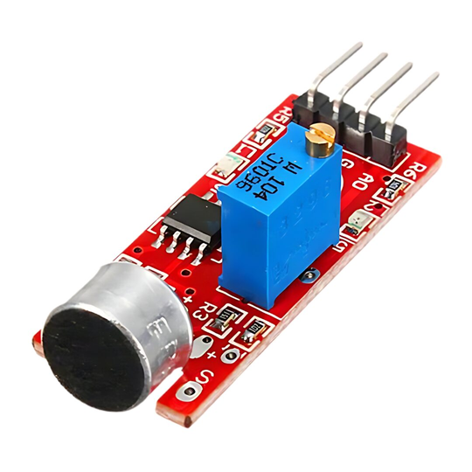
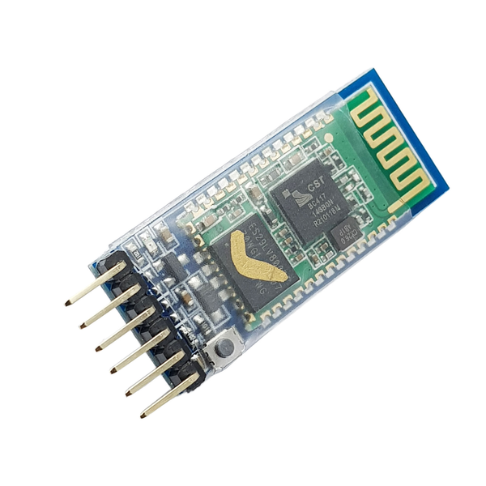
THE FUNCTION OF DEVICES
3. Sound Sensor:
The sound sensor detects and measures sound intensity, converting it into an electrical signal. It can send an output signal when the sound exceeds a certain threshold.
4.Bluetooth H05:
HC-05 is a Bluetooth module that utilizes the Serial Communication (UART) protocol to exchange data between devices, supporting both master and slave modes.

Slide 10
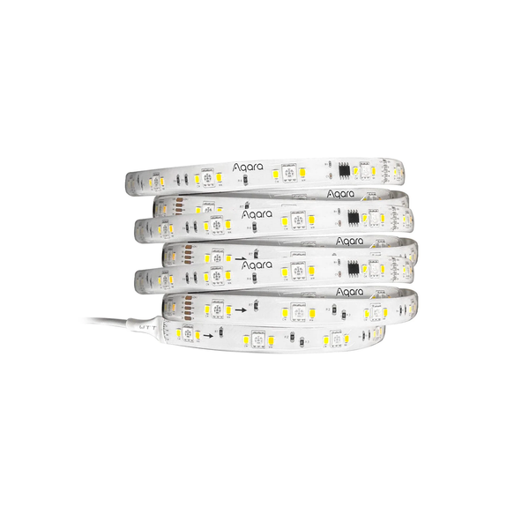
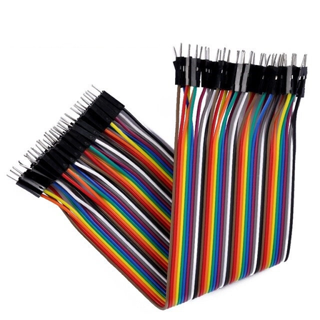
THE FUNCTION OF DEVICES
5. Led Strip
The LED strip can provide lighting and connect via Bluetooth to perform specific functions.
6. 40P cable
To connect electronic components in electronic circuits.

Slide 11
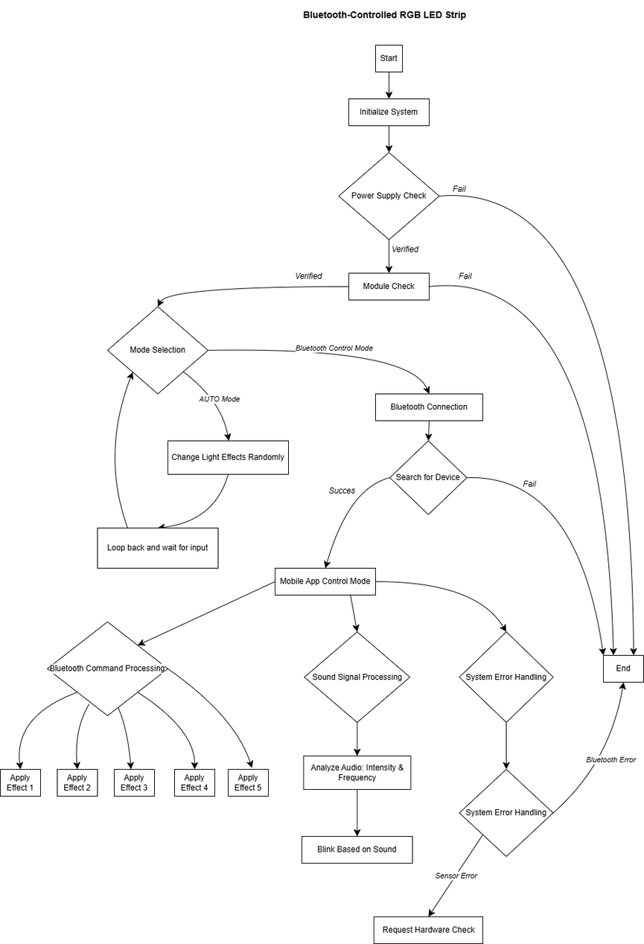
FLOWCHART

Slide 12
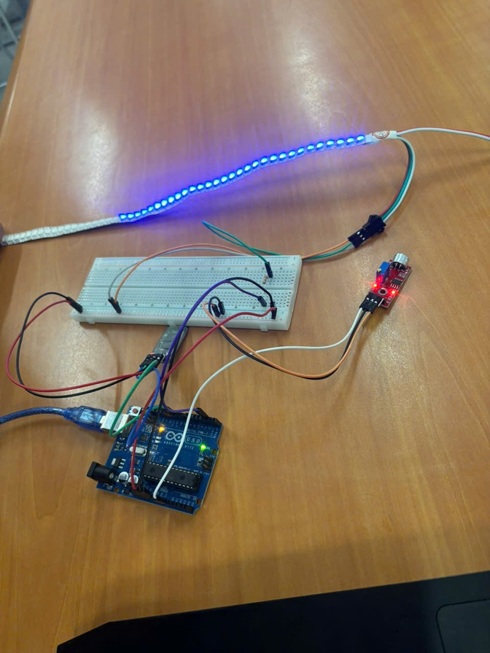
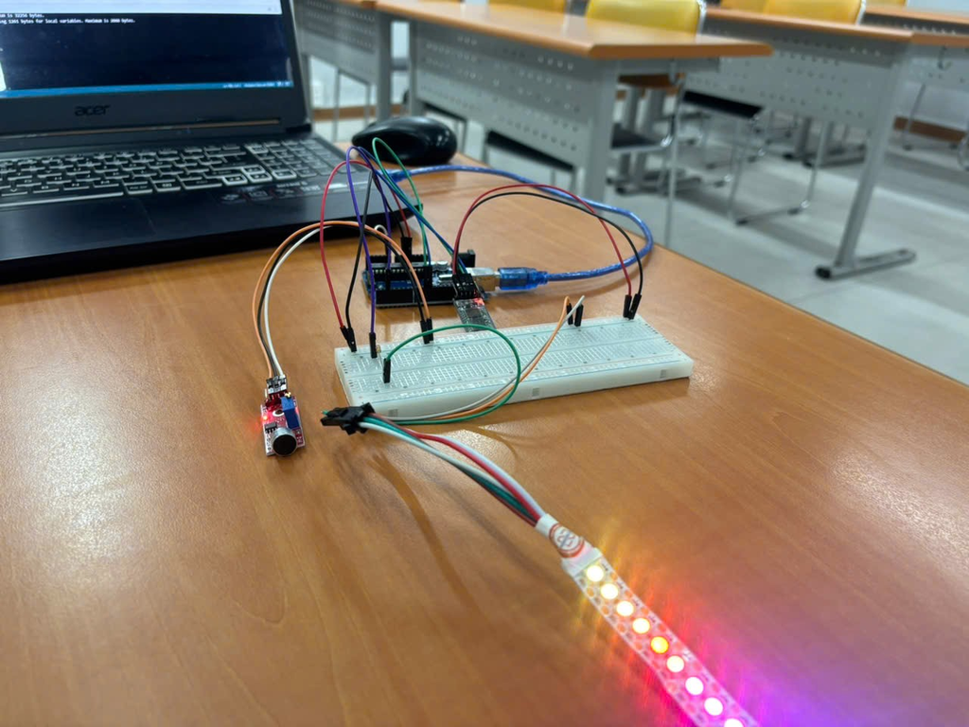
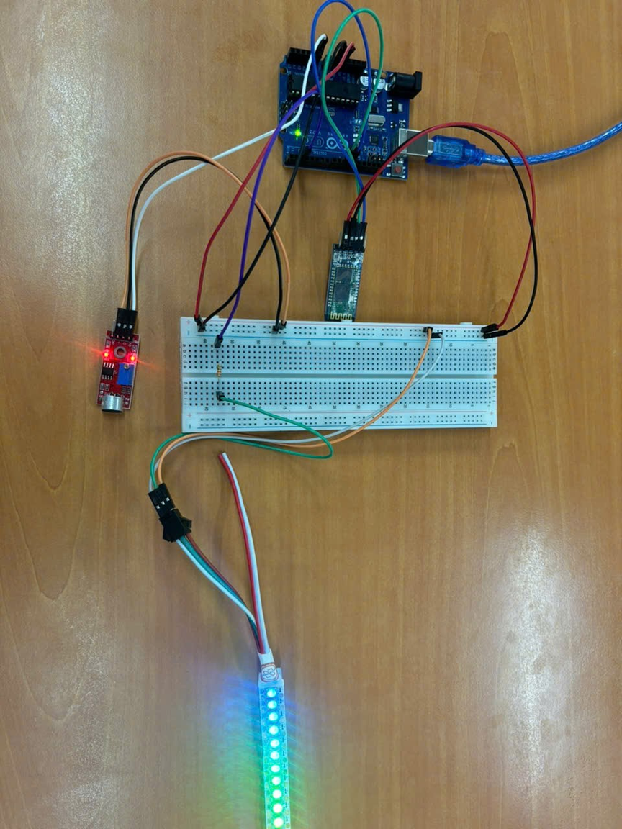
PROJECT’S IMAGE

Slide 13
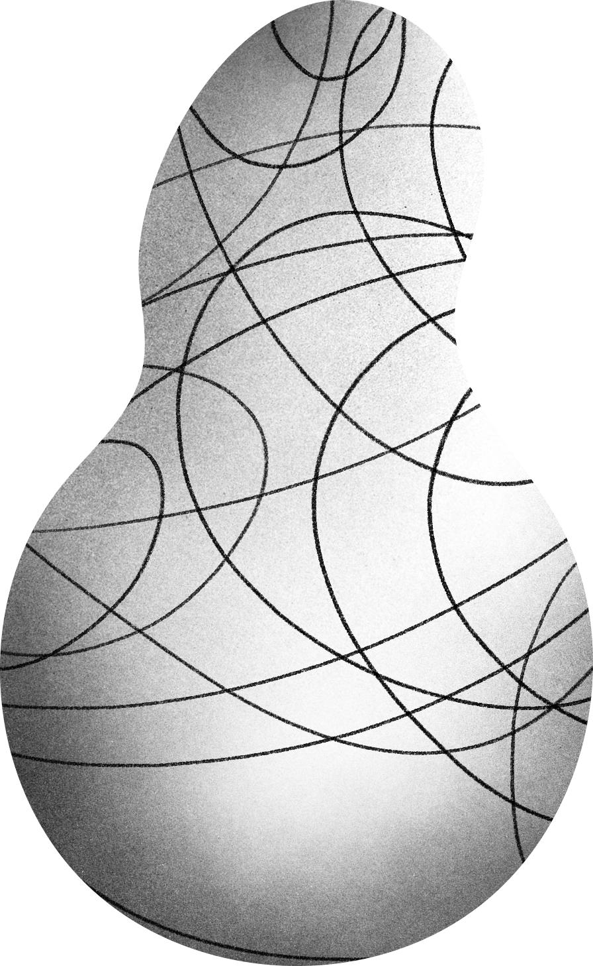


PROJECT’S VIDEO DEMO
Bluetooth Controlled Led Strip RGB - Group 2 - SE1817

Slide 14
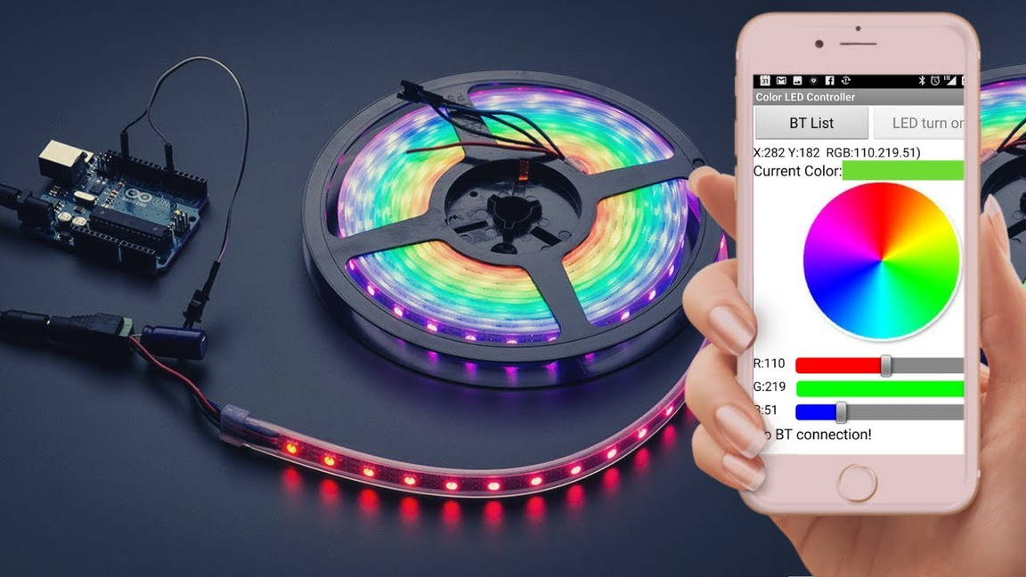
CONCLUSION
With the combination of Bluetooth and sound sensing, the RGB LED strip in this project not only allows users to control it remotely but also creates vibrant lighting effects in sync with music. This is a perfect solution for anyone looking to enhance their entertainment space, whether it be a bedroom, gaming room, café, or music party.

Slide 15
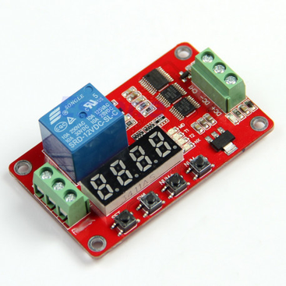
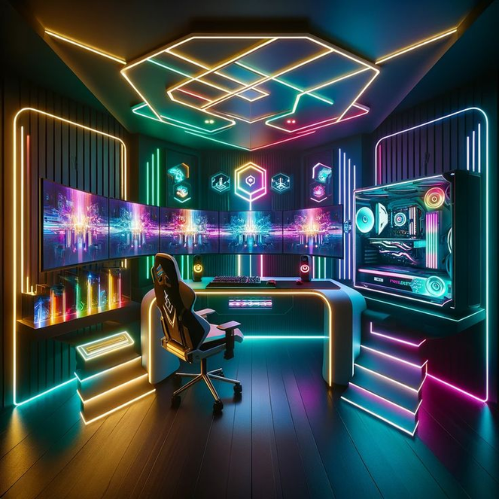
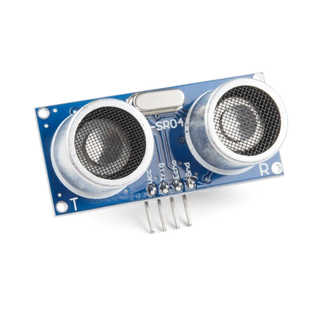
FUTURE DEVELOPMENT
This project can integrate a timer that allows users to set a schedule for automatically turning the lights on and off, which helps save energy and provides convenience in managing lighting in living spaces. A Timer component can be used to implement this feature.
Additionally, an ultrasonic sensor can also be integrated, enabling the LED strip to quickly respond to the presence of users. When a user approaches, the lights will automatically turn on, creating a welcoming atmosphere. The ultrasonic sensor component will be an effective solution for this feature, providing a smarter and more convenient experience for users.

Slide 16


THANKS FOR YOUR LISTENING
Bluetooth-Controlled RGB LED Strip
Do you have any question ???
GROUP 2
SE1817

